Slide 1
Design & Analysis of Algorithm
Alamin

Slide 2
What is design & analysis of Algorithm?
The design and analysis of algorithms is a fundamental field in computer science that focuses on developing efficient and effective algorithms to solve various computational problems. An algorithm is a step-by-step set of instructions or procedures to perform a specific task or solve a problem. Designing algorithms involves creating these instructions, while analyzing algorithms involves evaluating their efficiency and performance characteristics.

Slide 3
Why Analysis of Algorithms is important?
To predict the behavior of an algorithm without implementing it on a specific computer.
It is much more convenient to have simple measures for the efficiency of an algorithm than to implement the algorithm and test the efficiency every time a certain parameter in the underlying computer system changes.
It is impossible to predict the exact behavior of an algorithm. There are too many influencing factors.
The analysis is thus only an approximation; it is not perfect.
More importantly, by analyzing different algorithms, we can compare them to determine the best one for our purpose.

Slide 4
What is an Algorithm?
An algorithm is a finite set of unambiguous instruction that if followed accomplishes a particular task.
An algorithm should have finite number of steps.
It should accept input and produce desired output.
Algorithm should terminate.

Slide 5
Design of Algorithms?
Here's a breakdown of the key components of the design and analysis of algorithms:
Problem Definition: Clearly define the problem you're trying to solve. This could be a mathematical problem, a data processing task, or any computational challenge.
Algorithm Design Strategies:
Divide and Conquer: Break down a complex problem into smaller subproblems, solve them individually, and combine their solutions.
Dynamic Programming: Store and reuse solutions to subproblems to avoid redundant computations.
Greedy Algorithms: Make locally optimal choices at each step to find a globally optimal solution.

Slide 6
Backtracking: Explore all possible solutions by incrementally building a solution and undoing choices when they don't lead to a valid solution.
Randomized Algorithms: Introduce randomness to solve problems efficiently or probabilistically.
Algorithm Analysis:
Correctness: Ensure the algorithm produces the correct output for all possible inputs.
Efficiency: Measure the efficiency of an algorithm in terms of time complexity (how many operations it takes) and space complexity (how much memory it uses).
Scalability: Analyze how the algorithm's performance scales as the input size grows.
Optimality: Determine whether an algorithm achieves the best possible solution for a given problem.
Trade-offs: Consider the trade-offs between time complexity, space complexity, and other factors like simplicity and maintainability.

Slide 7
Types of algorithms analysis?
Best Case: Best case refers to the scenario in which an algorithm performs optimally, achieving the lowest possible time or space complexity for a given input.
Average Case: Average case represents the expected performance of an algorithm when considering all possible inputs, typically based on probability distributions.
Worst Case: Worst case refers to the scenario in which an algorithm performs at its maximum time or space complexity for a given input, representing the most resource-intensive situation.

Slide 8
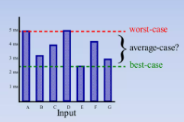
Types of algorithms analysis?

Slide 9
Types of complexity?
There are two types of complexity:
Space Complexity: Space complexity refers to the amount of memory or storage space an algorithm requires to complete its task, typically measured in terms of the additional memory used relative to the size of the input. It quantifies how efficiently an algorithm utilizes memory as the input size grows.
Time Complexity: Time complexity, on the other hand, measures the amount of computational time an algorithm takes to complete its task as a function of the input size. It helps assess how efficiently an algorithm performs in terms of execution time as the input size increases. Time complexity is often expressed using big O notation to describe the upper bound on the growth rate of the algorithm's running time with respect to the input size.

Slide 10
Both of the above complexities are measured with respect to the input parameters. But here arises a problem. The time required for executing a code depends on several factors, such as:
The number of operations performed in the program,
The speed of the device, and also
The speed of data transfer if being executed on an online platform.
So how can we determine which one is efficient? The answer is the use of asymptotic notation.
Asymptotic notation is a mathematical tool that calculates the required time in terms of input size and does not require the execution of the code.

Slide 11
It neglects the system-dependent constants and is related to only the number of modular operations being performed in the whole program. The following 3 asymptotic notations are mostly used to represent the time complexity of algorithms:
Big-O Notation (Ο) – Big-O notation specifically describes the worst-case scenario.
Omega Notation (Ω) – Omega(Ω) notation specifically describes the best-case scenario.
Theta Notation (θ) – This notation represents the average complexity of an algorithm.

Slide 12
Order Of Growth:
Goals:
want to evaluate the program efficiency when input is very big.
want to express the growth of programs run time as input size grows.
want to put an upper bound (worst case) on growth – as tight as possible.
do not need to be precise: “order of” not “exact” growth.
we will look at largest factors in run time (which section of the program will take the longest to run?)
thus, generally we want tight upper bound on growth, as function of size of input, in worst case.

Slide 13
Measuring Order Of Growth (Big O Notation):
Big O notation measures an upper bound on the asymptotic growth, often called order of growth.
Big O or O() is used to describe worst case
Worst case occurs often and is the bottleneck when a program runs.
Express rate of growth of program relative to the input size.
Evaluate algorithm Not machine or implementation.

Slide 14
What is time complexity?
Time complexity is a fundamental concept in the analysis of algorithms. It quantifies the amount of time an algorithm takes to run as a function of the size of its input. It helps us understand how the algorithm's performance scales with increasing input sizes. Time complexity is typically expressed using big O notation, which provides an upper bound on the growth rate of the algorithm's running time.

Slide 15
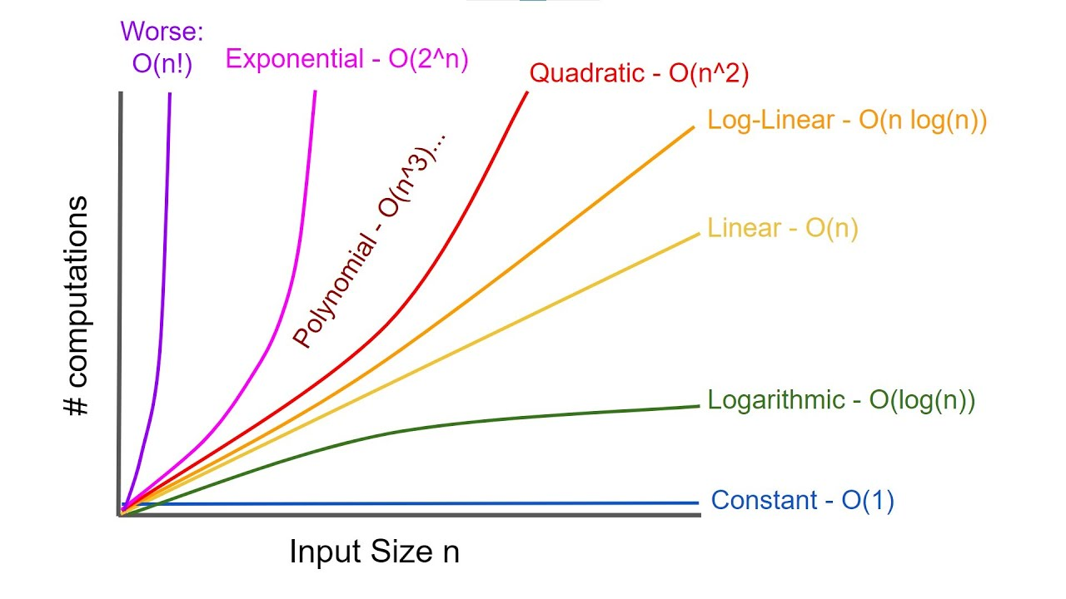
Time complexity graph?

Slide 16
Different time complexity?
Time complexity is a fundamental concept in the analysis of algorithms. It quantifies the amount of time an algorithm takes to run as a function of the size of its input. It helps us understand how the algorithm's performance scales with increasing input sizes. Time complexity is typically expressed using big O notation, which provides an upper bound on the growth rate of the algorithm's running time.
In big O notation, the time complexity of an algorithm is represented as "O(f(n))," where "f(n)" is a function that describes the upper bound on the number of basic operations (or steps) the algorithm takes as a function of the input size "n." Here are some common time complexity classes and their meanings:

Slide 17
Different time complexity?
O(1) - Constant Time: The algorithm's running time does not depend on the input size. It takes a constant amount of time to complete, regardless of how large the input is.
O(log n) - Logarithmic Time: The algorithm's running time increases logarithmically with the input size. Common with algorithms that divide the problem into smaller subproblems, such as binary search in a sorted list.
O(n) - Linear Time: The algorithm's running time increases linearly with the input size. Each input element is processed once.
O(n log n) - Linearithmic Time: Often seen in efficient sorting algorithms like merge sort and quicksort. The running time grows faster than linear but slower than quadratic.
O(n^2) - Quadratic Time: The running time is proportional to the square of the input size. Common with algorithms that involve nested loops, processing each input element against all other elements.

Slide 18
Different time complexity?
O(n^k) - Polynomial Time: Similar to quadratic time, but with a higher exponent "k." Polynomial time complexities like cubic (O(n^3)) or quartic (O(n^4)) are less efficient for large input sizes.
O(2^n) - Exponential Time: The running time grows exponentially with the input size. Often seen in brute-force algorithms that explore all possible combinations of input elements.
O(n!) - Factorial Time: The running time grows factorially with the input size. Highly inefficient and often impractical for even moderate input sizes.
When analyzing the time complexity of an algorithm, it's important to consider the worst-case scenario, as this provides an upper bound on the algorithm's performance. Additionally, factors like the specific operations performed in each step and the machine's architecture can influence the actual runtime.
As a programmer, understanding the time complexity of algorithms helps you choose the most appropriate algorithm for a given problem, optimize code for performance, and make informed decisions when developing software.

Slide 19
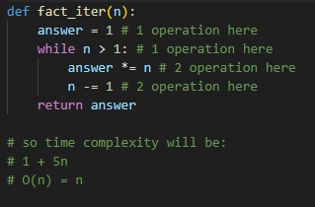
Measuring time complexity?
time
Count all the operations of the program.
Worst case asymptotic complexity:
Ignore additive constants.
Ignore multiplicative constants.
input

Slide 20















Some Exercise
$${=n}^{2}+2n+2$$
$${=n}^{2}+200000n+3^{10000}$$
$$=log(n)+n+2$$
$${O(n)=n}^{2}+2n$$
$${O\left(n\right)= n}^{2}+200000n$$
$$O\left(n\right)= log(n)+n$$
$${O(n)=n}^{2}+n$$
$${O\left(n\right)= n}^{2}+n$$
$$O\left(n\right)= n$$
$${O(n)=n}^{2}$$
$${O\left(n\right)= n}^{2}$$
$$=0.001∗n∗log(n)+300n$$
$$O(n)=n∗log(n)+n$$
$$O(n)=n∗log(n)$$
$$O\left(n\right)=n log(n)$$

Slide 21
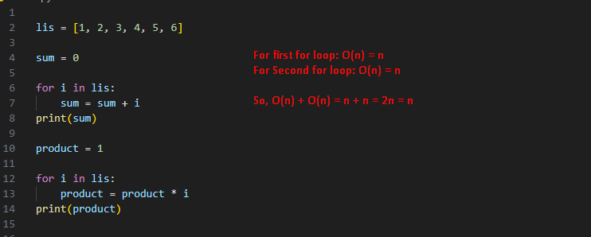
How to calculate time complexity?

Slide 22
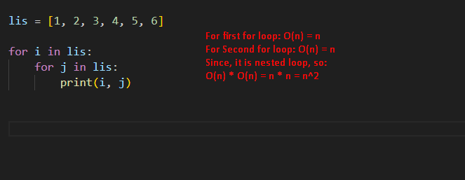
How to calculate time complexity?

Slide 23
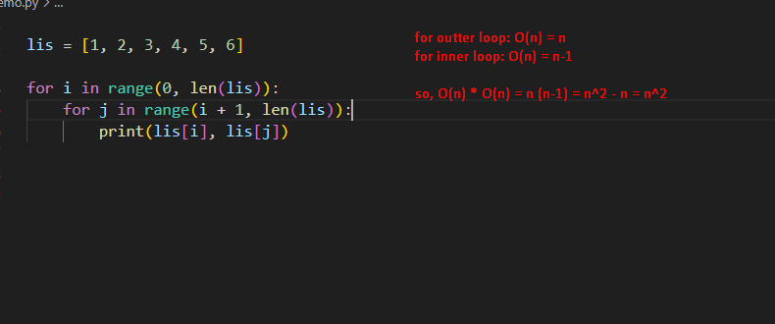
How to calculate time complexity?

Slide 24
Important problems types
Sorting.
Searching.
String processing.
Graph problems.
Combinatorial problems.
Geometric problems.
Numerical problems.

Slide 25
Complexity Classes
P class.
NP class.
NP hard class.
NP complete class.

Slide 26
References
https://www.geeksforgeeks.org/design-and-analysis-of-algorithms/?ref=outind
https://www.geeksforgeeks.org/learn-data-structures-and-algorithms-dsa-tutorial/?ref=outind
https://www.geeksforgeeks.org/types-of-complexity-classes-p-np-conp-np-hard-and-np-complete/
Hjh

